Slide 1
Rapid detection of fentanyl using a multifunction nanostructured substrate
Senior Design Team sddec19-07
Olouwole Eteka,Kossi Egla, Zheyuan Tang,Ugerah Abalu,Hao Wang,Yifu Zhang
Advisor: Dr Meng Lu
Client :Dr Meng Lu
http://sddec19-07.sd.ece.iastate.edu/team.html

Slide 2
Project plan

Slide 3
Problem Statement
The purpose of this project is to design a system that can detect fentanyl in a mixture of chemicals by separating compounds. Our proposed system will use thin layer chromatography and optical instrumentation to carry out this separation and hence detect any presence of fentanyl

Slide 4
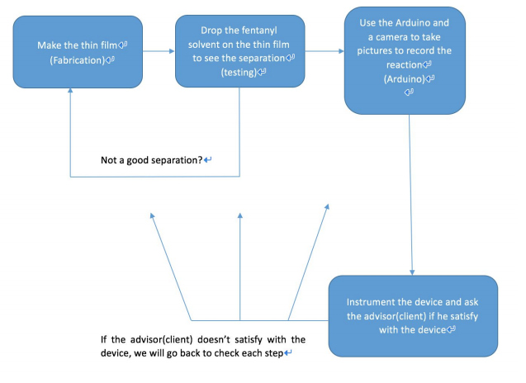
Conceptual Sketch

Slide 5
Functional Requirements
Detect possible presence of fentanyl in mixtures that are suspected to contain fentanyl
Adaptability: Ability to use device under different conditions i.e different temperature and lightning conditions

Slide 6
Non-functional Requirements
Capture good images of separation process from which more data can be extracted including: position of fentanyl on sensor and the speed of separation process
Minimal delay in image capturing
Possibility to expand device specifications to calibrate device for use in detecting other chemicals in the future

Slide 7
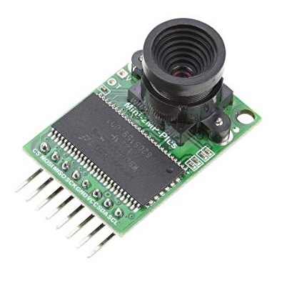
Technical considerations
For the project, we are using arducam and arduino board
Arducam OV 2560: is a camera specially designed to be used on an arduino board.
2.Arduino board: is an open-source electronics platform based on easy-to-use hardware and software. You can tell your board what to do by sending a set of instructions to the microcontroller on the board

Slide 8
Market survey
In March 2018, the U.S Customs and Border patrol(CBP) ,at the Dallas International Airport, trialed a new handheld Gemini Thermo scientific analyzer to quickly and non intrusively detect unknown chemicals and explosives. Another product being used is the Thermo Scientific TruDefender FT Handheld FTIR Material identification, which costs about $19,000 to purchase. Our proposed product would be designed to specifically detect the highly potent fentanyl in mixtures and be a lot more cost effective to use.

Slide 9
●Potential Risks & Mitigation
Chromatography
1. Volatility
2. Data Error
Instrumentation
1. Camera resolution

Slide 10
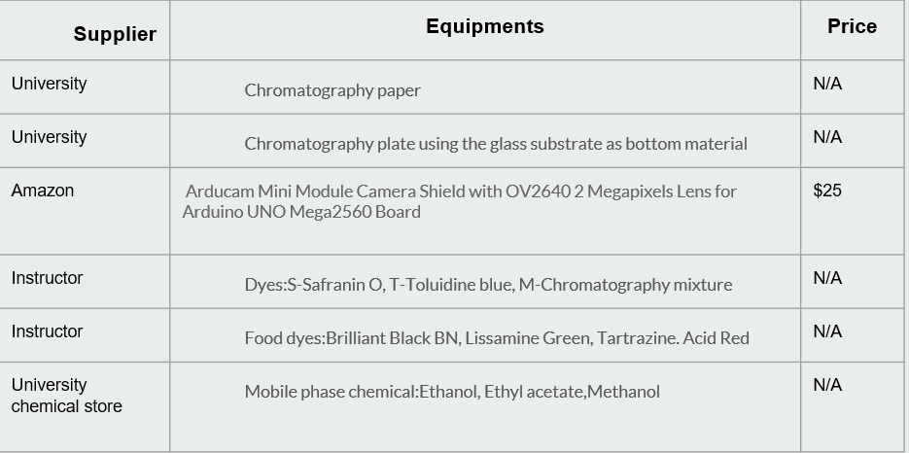
●Resource/Cost Estimate

Slide 11
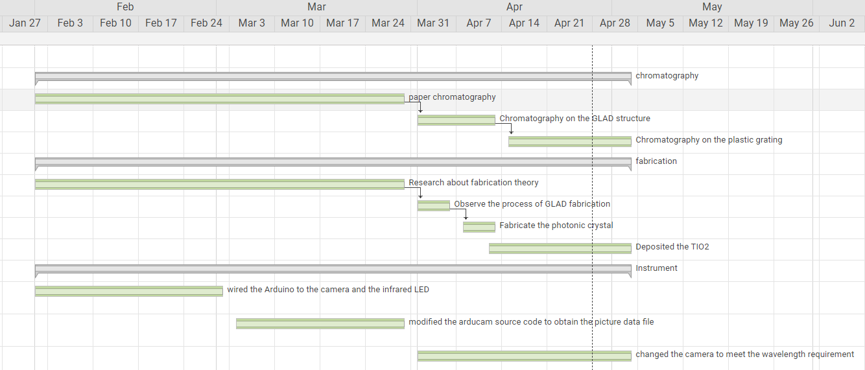
Project Milestones & Schedule

Slide 12
Project Milestones & Schedule

Slide 13
System Design
Subgroups
Fabrication
Testing
Instrumentation

Slide 14
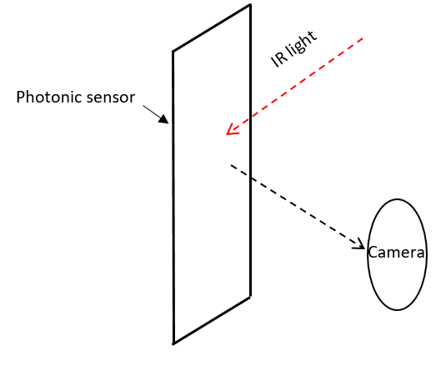
Functional Decomposition

Slide 15
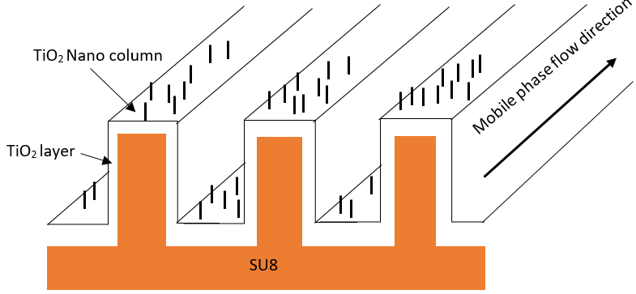
Photonic sensor structure diagram

Slide 16
Fabrication for photonic sensor

Slide 17
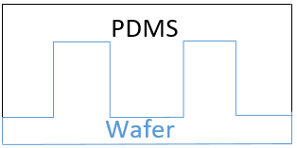
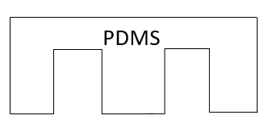
Remove PDMS and do hydrophobic treatment
Coat PDMS

Slide 18
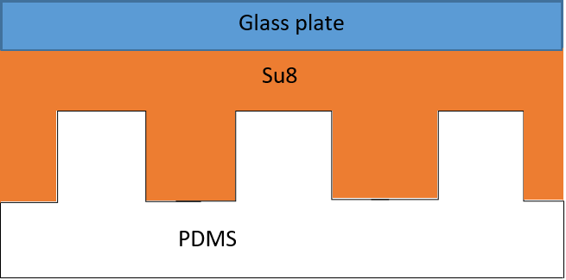
Coat Su8 on glass plate and spin it
Squeeze the PDMS model on the glass plate

Slide 19
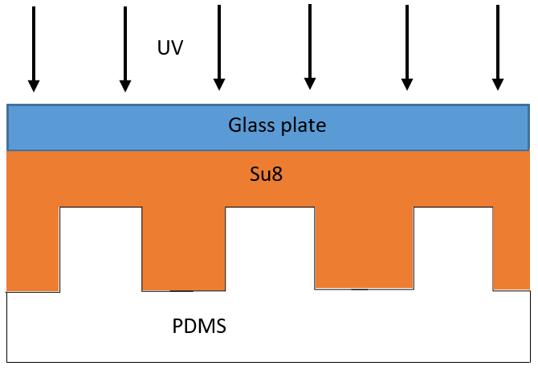
Exposure under the UV light
Remove PDMS

Slide 20
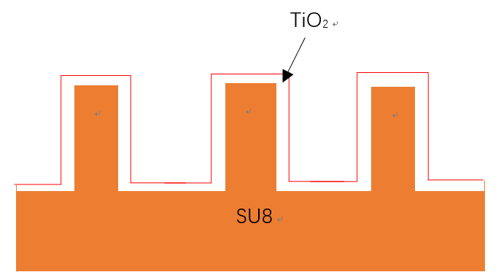
Deposited TiO2 layer by sputtering
Notes:
an an ion beam is focused on a target and sputters material onto a substrate. The process is monoenergetic and highly collimated as ions possess equal energy and directionality.
percise

Slide 21
Glancing angle deposition

Slide 22
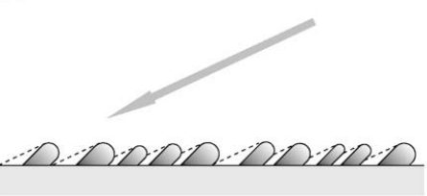
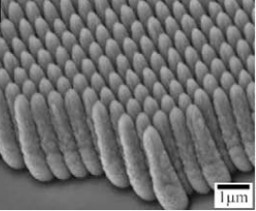
TiO₂ Nano column

Slide 23
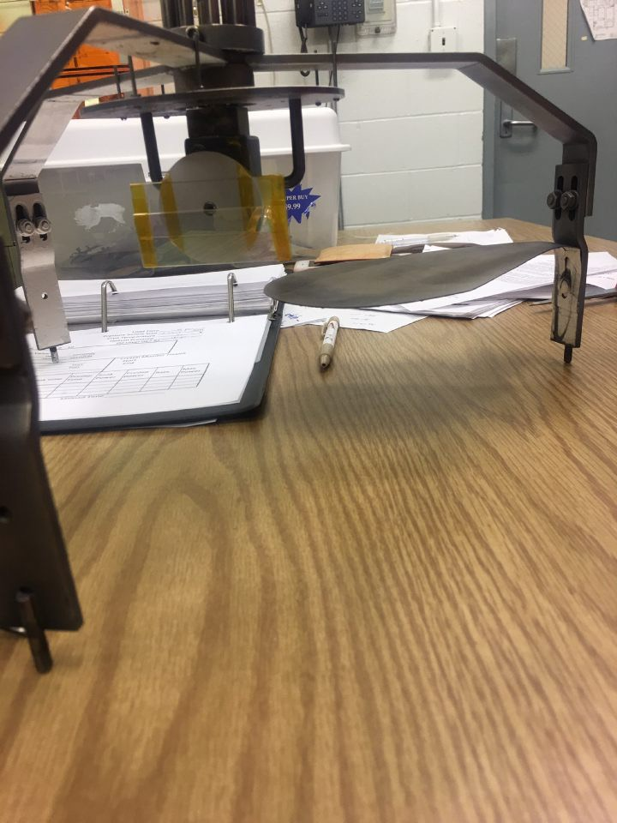
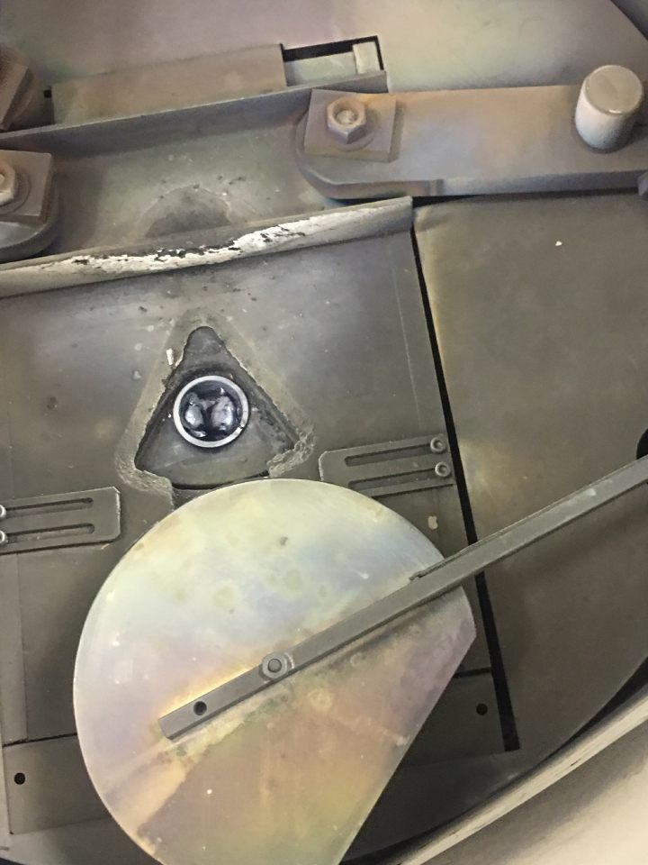
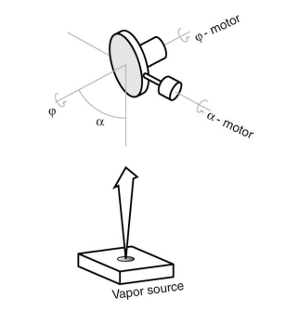
Notes:
uses an electron beam to focus a large amount of energy onto the source material and produces a very high temperature, which allows metals to be vaporized, and then deposited on a substrate to form a thin filmExcellent uniformity

Slide 24
Test plan
Paper Chromatography (familiarize with the principle)
Test food dyes by Ultra Thin Layer Chromatography (prove the principle)
Test food dyes on photonic crystal (apply the way on the design)
4. Test Fentanyl and other chemicals on photonic sensor ( achieve the goal)

Slide 25
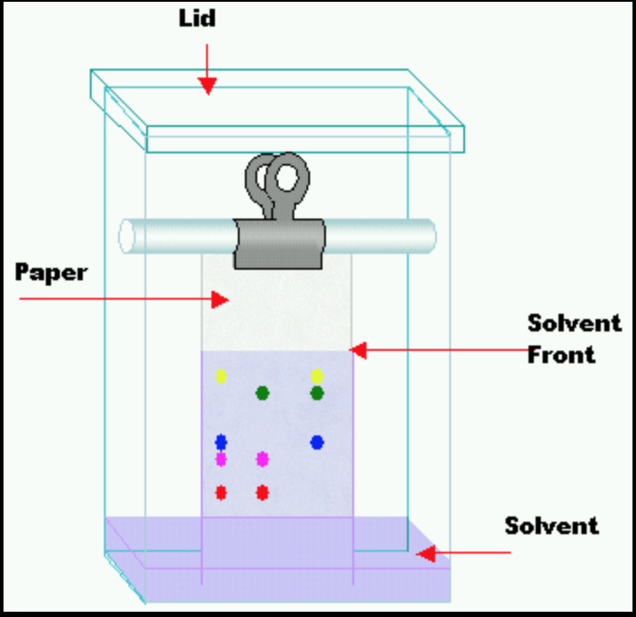
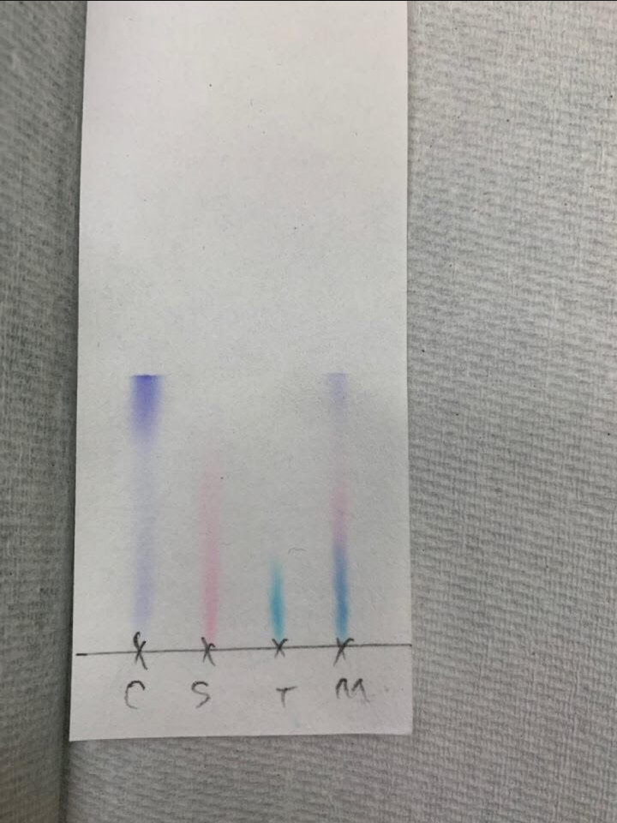
Paper chromatography
Stationary phase: water (Polar)
Mobile phase: Ethanol (Non-polar)
Dyes: “S-Safranin O”, “T-Toluidine blue”, “M-Chromatography mixture”

Slide 26
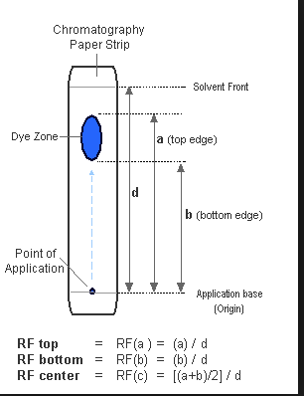
RF Value calculation

Slide 27
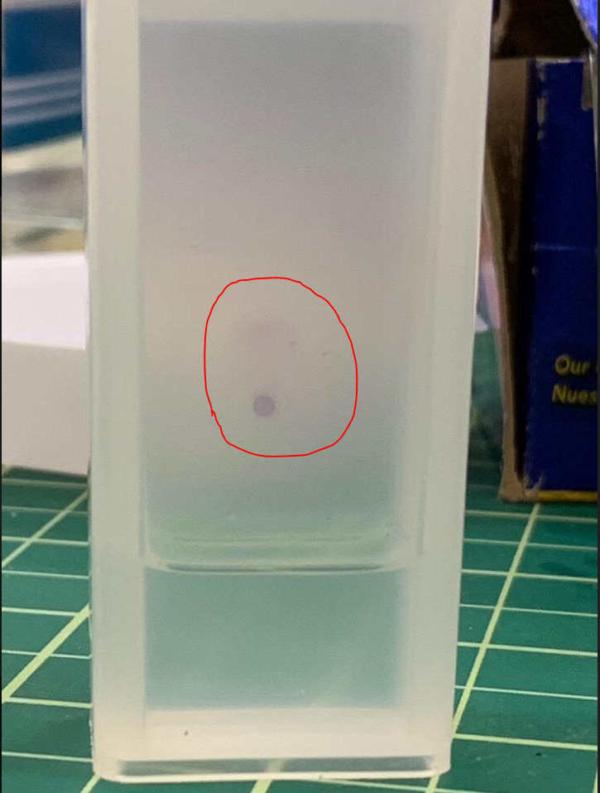
Ultrathin-Layer Chromatography (UTLC)
Stationary phase: TIO2 Nano column
Mobile phase:ethyl acetate/methanol/water(65/23/5)
Dyes: Food dyes(Brilliant Black BN (1mg/ml), Lissamine Green (6mg/ml), tartrazine(12mg/ml), Acid Red 14(12mg/ml)
Julia Wannenmacher a,b, Steven R. Jimc, Michael T. Taschukc, Michael J. Brett c,d, Gertrud E. Morlocka,b,∗
“Ultrathin-layer chromatography on SiO_{2, Al2O3, TiO2, and ZrO2} nanostructured thin films”31 july 2013.
https://www.journals.elsevier.com/journal-of-chromatography-a

Slide 28
Status of testing plan
Paper Chromatography (familiarize with the principle)
Test food dyes by Ultra Thin Layer Chromatography (prove the principle)
Test food dyes on photonic sensor (application) In processing
Test Fentanyl with other chemicals on photonic sensor ( achieve the goal) Start next semester

Slide 29
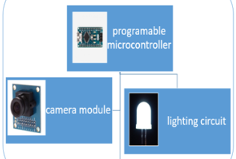
HW/SW/Technology Platform(s) used
Microcontroller :
Arduino uno
2. Camera :
Model OV2640
ARDUCAM user interface
Code librairie included
3. lighting:
Infrared LED

Slide 30
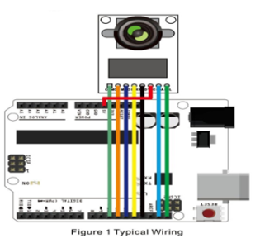
Wiring

Slide 31
Specifications
1. 90° infrared reflection from the photonic sensor to the camera
2. The camera will be capturing those light reflection as the separation process take place

Slide 32
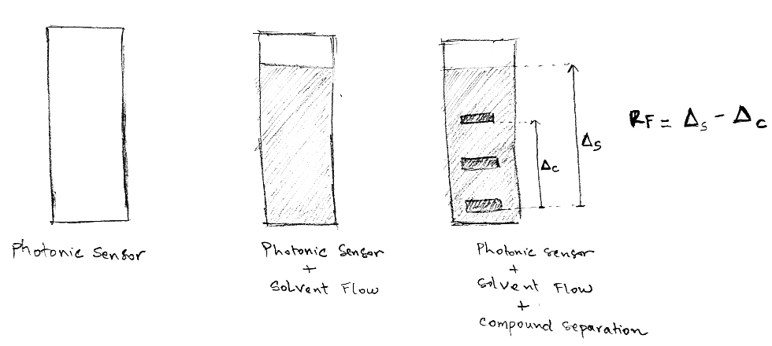
Specifications
3. Calculation of retention value(distance travel by the solution /distance travel by a solvent) based on these images

Slide 33
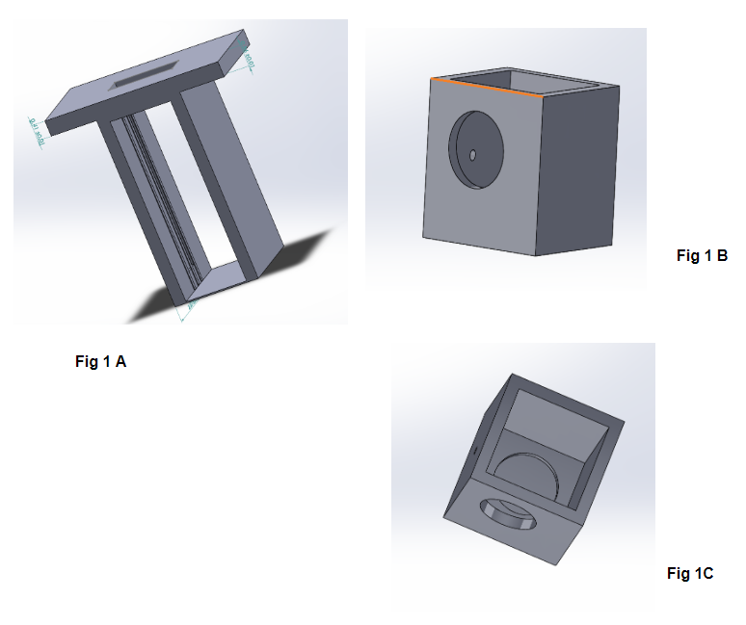
Prototype Implementations
Figure 1A: photonic sensor holder
Figure 1B: configuration of the box with the holes for the camera and LED
Figure 1C: interior view of the box. It has a container inside to hold the solvent

Slide 34
Conclusion
Current project status with respect to milestones
●Completed all the deliverables for this semester:
Paper Chromatography test: Helped us to get a good first understanding of the principle of chromatography
Ultra Thin film nanostructure layer fabrication: Created the thin film and experimented separation using food dye. We are using food dye as a test case as we are still awaiting clearances to get access to fentanyl
Arduino camera:The instrumentation focused on programming the arduino camera to capture as many pictures within a certain timeframe. The team will make sure the speed and format of the data matches on the windows/mac system

Slide 35
Plan for next semester
Our main deliverable next semester is the development of the Ultra Thin film nanostructure separation (Photonic sensor) to use in the separation of fentanyl mixtures and successfully integrate this sensor with our prototype structure developed this semester

